Slide 1
Graph Theory Project
Group Members
2021-CS-665
2021-CS-653

Slide 2
Introduction
Document classification is a crucial task for information management. In this project, we propose a novel approach using graph-based representations and the KNN algorithm with Minimum Common Subgraph (MCS) distance.
By representing documents as graphs and utilizing MCS distance, we aim to improve classification accuracy.
This report presents our methodology, experimental setup, and results, demonstrating the effectiveness of our approach compared to traditional methods.

Slide 3
Problem Statement
The project focuses on utilizing graph-based representations of documents and implementing the K-nearest neighbors (KNN) algorithm with MCS distance for document classification.

Slide 4
Methodology
My initial step involves scraping code from a URL.
Next, I apply preprocessing to the scraped data.
Finally, I store the cleaned data in a file.

Slide 5
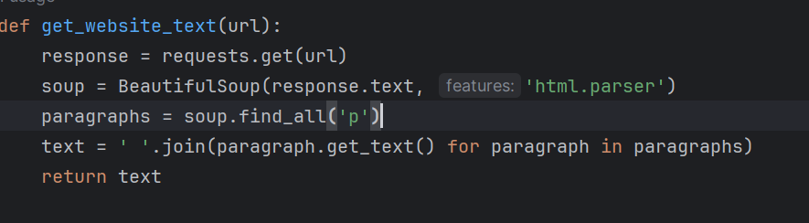
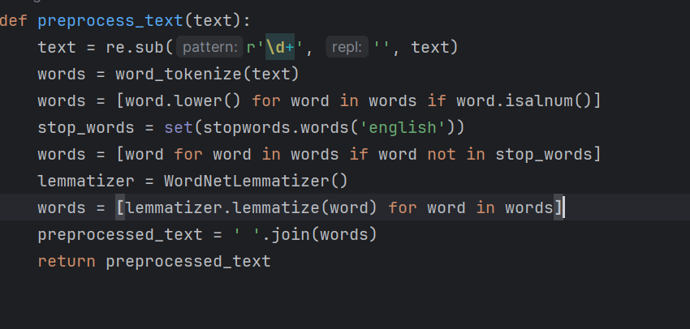

Slide 6
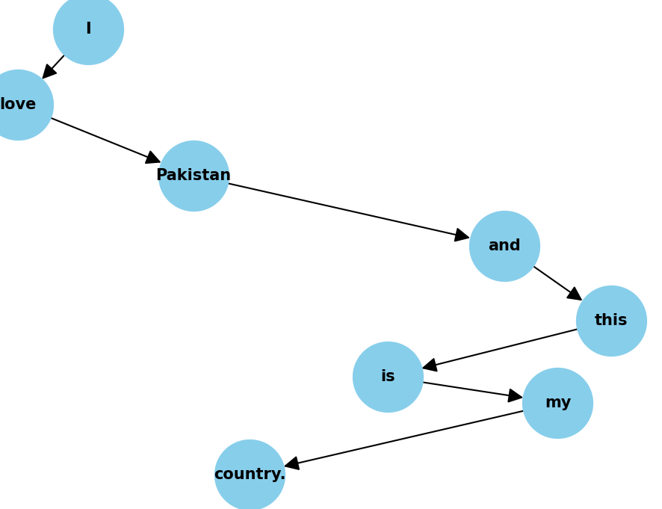
Methodology
Graph Creation.
Sentence: I love Pakistan and this is my country.

Slide 7
Methodology
KNN Function
Now after finding MCS distance we need to write a function that will calculate the distance from all the graph and then find the k-nearest graphs labels and assign the test graph with that label.

Slide 8
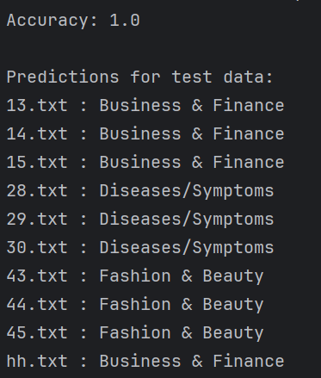
Accuracy and Predictions

Slide 9
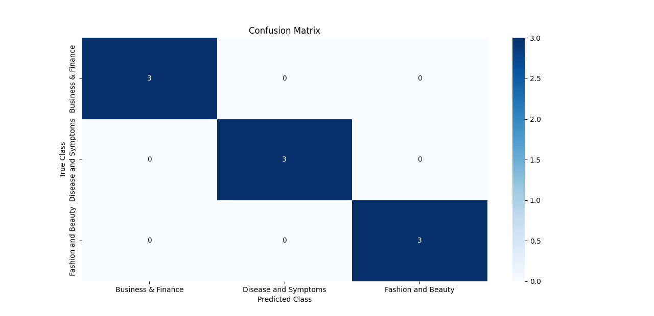
Confusion Matrix

